Slide 1
CAPSTONE PROJECT:
THE BATTLE OF NEIGHBOURHOODS

Slide 2
INDEX:
INTRODUCTION/BUSINESS PROBLEM
DATA COLLECTION
EXPLORATORY DATA ANAYSIS
DATA PREPARATION AND PROCESSING
MODELING
DISCUSSION/CONCLUSION

Slide 3
INTRODUCTION/BUSINESS PROBLEM
This analysis explores the most suitable locations for a business personnel to invest or open a Finger Millet (locally known as ‘Ragi’) processing unit in the state of Tamil Nadu in India.
Tamil Nadu is the tenth largest Indian state by area and the sixth largest by population and comprise of 37 districts.
The economy of Tamil Nadu is the second-largest state economy in India. Tamil Nadu has historically been an agricultural state and is a leading producer of agricultural products in India.

Slide 4
Scenario and Objective:
Business personnel who wants to invest or open a Finger Millet processing unit as a side business.
The objective is to find the best locations that has good amount of irrigated area of high-yield Finger Millet, with good amenities/facilities and connectivity to other cities.

Slide 5
DATA COLLECTION
For this project we need the following data:
The data that contains Finger millet irrigated area for each of the districts in TamilNadu is extracted,
Data Source: https://tn.data.gov.in
Description: This data set contains the required information. And we will use this data set to explore the Finger millet irrigated area. The geographical coordinates are appended to this data using the geocoder
All the venues for each of the distric are extracted using Foursquare API
Data Source: Foursquare API
Description: By using this API we will get all the venues in each of the districts in Tamil Nadu

Slide 6
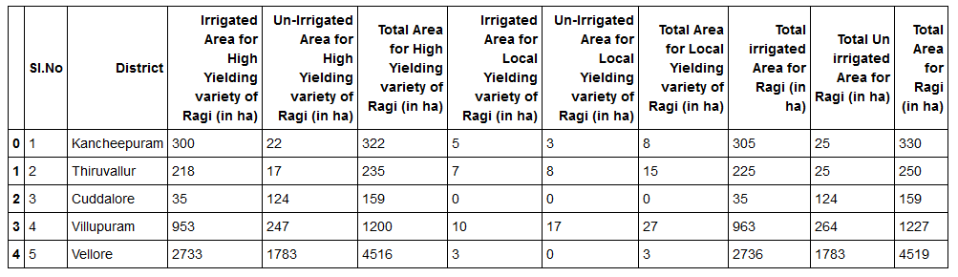
EXPLORATORY DATA ANALYSIS
The raw data of ‘Finger millet irrigated area’ in 32 districts of Tamilnadu. There are 11 columns including data regarding irrigated, un-irrigated for high, local yield etc.,

Slide 7
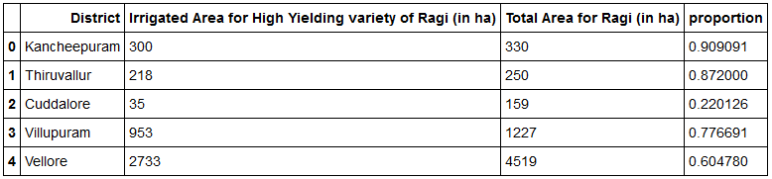
EXPLORATORY DATA ANALYSIS (contd.)
Since the objective is determine the districts with high proportion of irrigated area for high yielding variety of ragi and decently equipped with ameneties/facilities and has good connectivity.

Slide 8
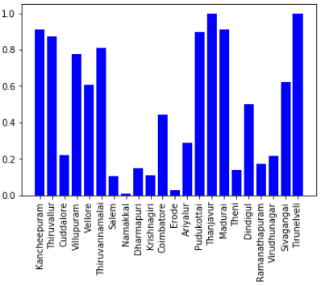
EXPLORATORY DATA ANALYSIS (contd.)
To further the analyses, those districts with proportion of at least 0.005 of Ragi irrigated area were filtered.
It can be observed from the plots, that the districts 'Tirunelveli' and 'Thanjavur' has higher proportion of Irrigated Area for High Yielding variety of Ragi.
Further, to determine the feasible location for the settling, amenities, facilities and the connectivity need to be assessed.

Slide 9
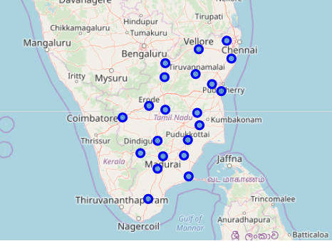
DATA PREPARATION & PROCESSING
We add the geographical coordinates to these 22 districts and plot them on the map,

Slide 10
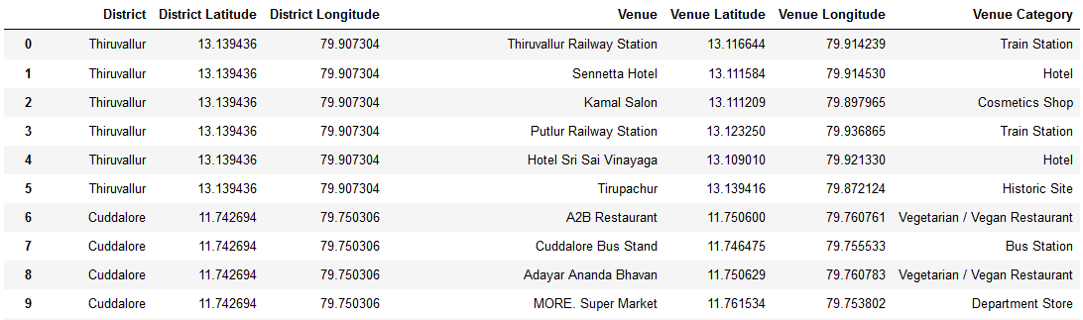
DATA PREPARATION & PROCESSING (contd.)
We get the nearby venues using FourSquare and append to our data. And the sample data looks like,

Slide 11
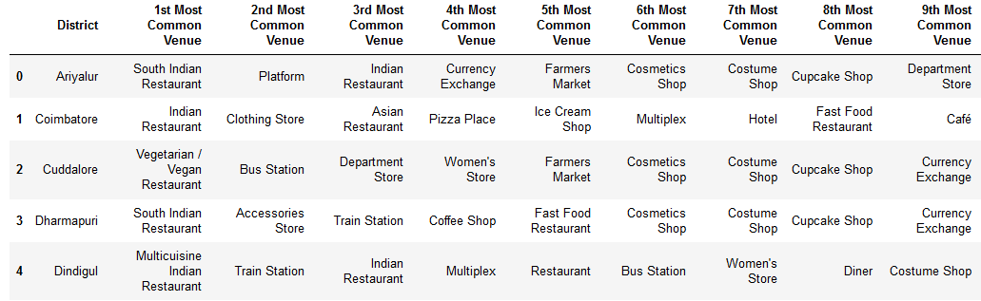
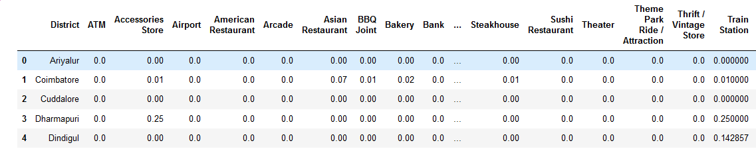
DATA PREPARATION & PROCESSING (contd.)
The processing of the data include
Grouping the venues
Finding the frequency of venues and the top venues with each district.

Slide 12
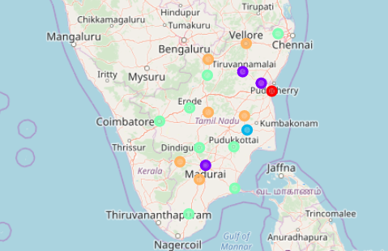
MODELING
Using the data of Venue frequency, we cluster the districts using Kmeans similarity.
The clusters plotted on map as below,

Slide 13
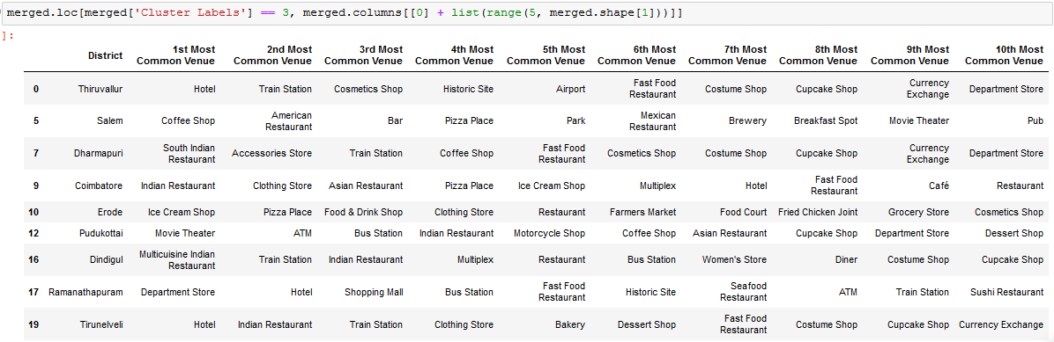
DISCUSSION/CONCLUSION
This is also appended to the data with venues listed in order of frequency.
Considering all the clusters, we find the cluster’3’ is relatively equipped with amenities. And considering the irrigated area for Ragi, ‘Tirunelveli’ could be a good choice to invest or open a Finger Millet processing unit as a side business.

